Slide 1
Individual Presentation
MATRIX COLLEGE OF MANAGEMENT TECHNOLOGY & HEALTH
Final Year Project Report On
“Install Virtual Network / Test Web Application”
Presented By
Vikas Khokhariya(1951660)
Submitted to
Christobell Cuya
Hansy Ross Salvant

Slide 2
Introduction
Creating Virtual Environment with Three Machines
Configuration of Machines
Web platform Install
Deploy the web application
Test the web application

Slide 3
Networking Structure
This networking structure describes how the virtual environment has been created.
Three Systems are installed.
1. SVR-SO-A (Router)
2. SVR-WS-A (Web Server)
3. Client 8.1

Slide 4
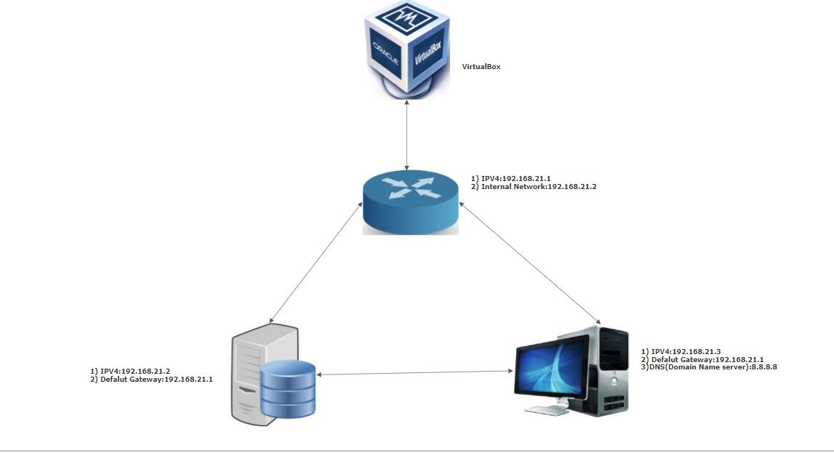
Network Diagram

Slide 5
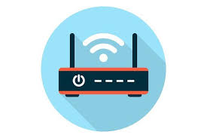
1) Router
Heart of the System
Receive and move incoming packets to its own network or another network.
It connects one more devices to each other using Network.
Named as SVR-SO-A.

Slide 6

2) Web Server
Program that uses HTTP (Hypertext Transfer Protocol) to serve the files that form Web pages to users.
In response to their requests, which are forwarded by their computers' HTTP clients.
Named as SVR-WS-A.

Slide 7

3) Client
A client is a computer hardware device or software that accesses a service made available by a server.
Clients can access resources such as files, songs, video collections, or some other service from a central computer called a server.

Slide 8
System Creation
Installation of Virtual Box
Installation of Router
Installation of Web-server
Installation of Client 8.1

Slide 9
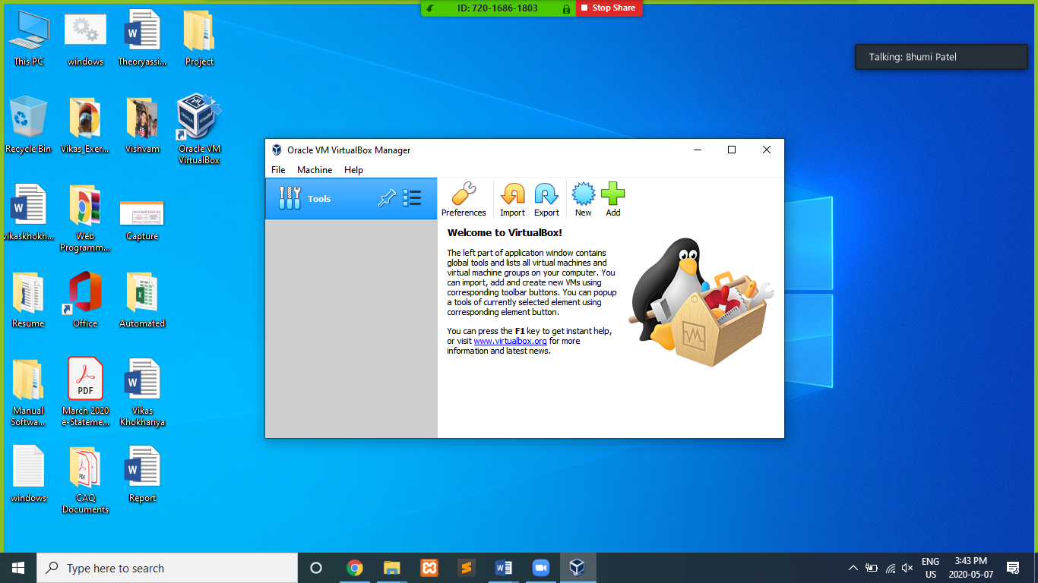
Installation of Virtual Box
Install the Virtual Box.

Slide 10
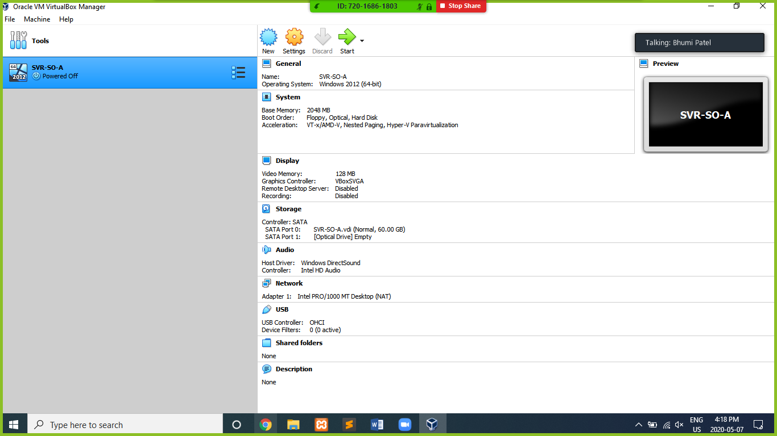
Installation of Router(SVR-SO-A)
Set two Adapters
1) NAT Adapter
2) Internal Network

Slide 11
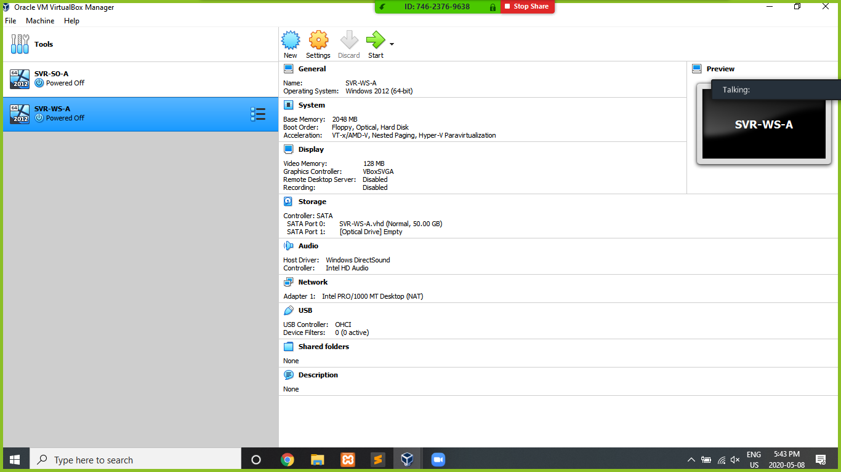
Installation of Web-Server(SVR-WS-A)
Set Adapter 1 as Internal Network.

Slide 12
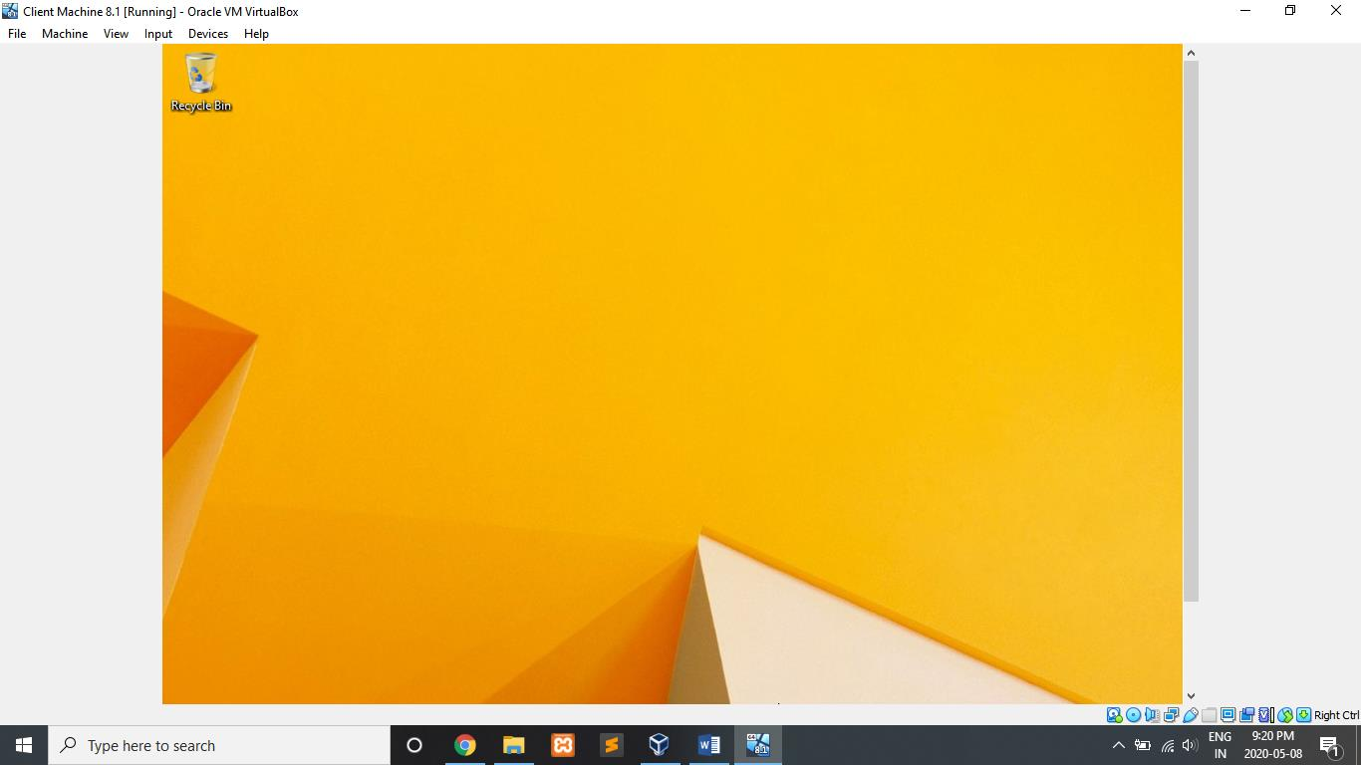
Installation of Client Machine

Slide 13
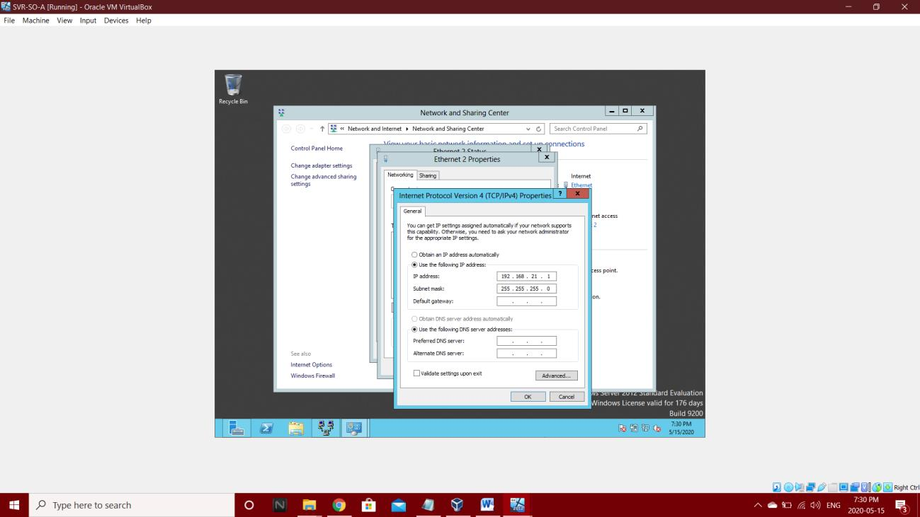
Configuration of System 1) Router (SVR-SO-A)
In Network and sharing Center go to Ethernet and then select Internet Protocol version 4(TCP/IPv4)
select obtain an IP address automatically for Ethernet 1
IP address – 192.168.21.1 for Router

Slide 14
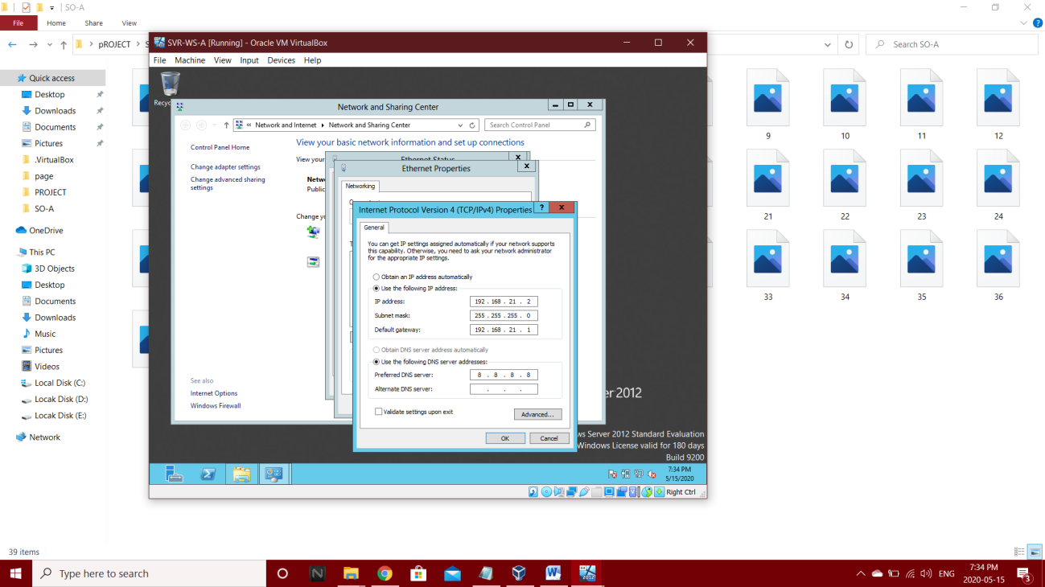
2) Web-Server (SVR-WS-A)
In Network and sharing Center go to Ethernet and then select Internet Protocol version 4(TCP/IPv4)
Provide IP address as 192.168.21.2
Provide Default Gateway as 192.168.21.1
Provide preferred DNS as 8.8.8.8 .

Slide 15
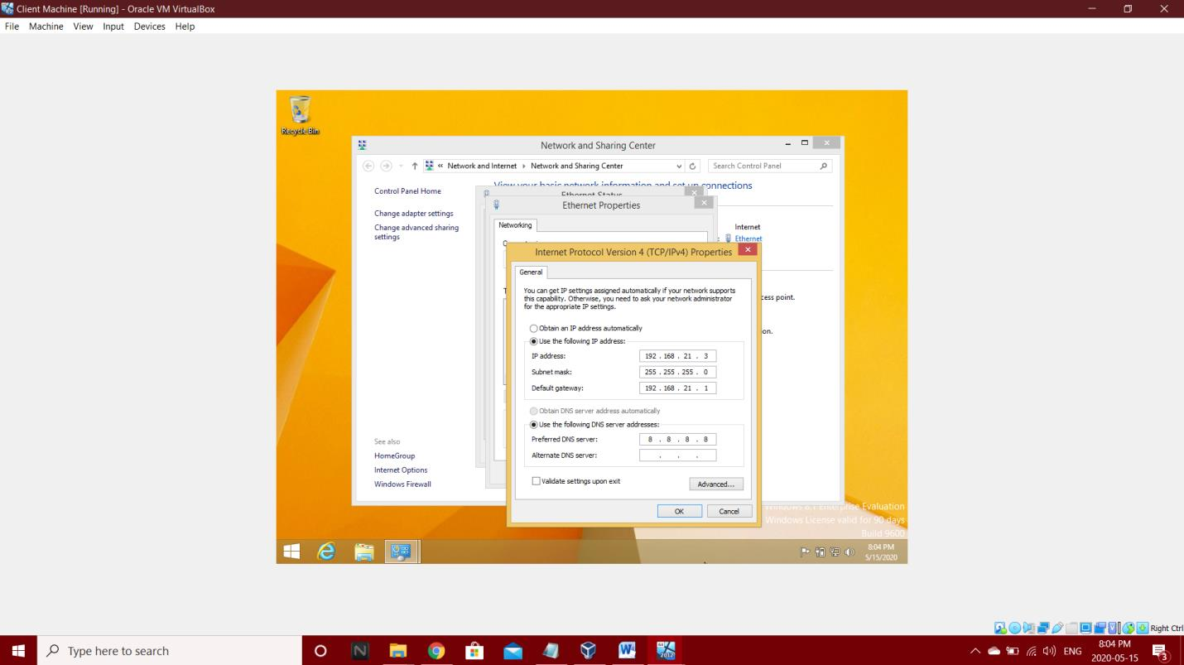
3) Client Machine
In Network and sharing Center go to Ethernet and then select Internet Protocol version 4(TCP/IPv4)
Provide IP address as 192.168.21.3
Provide Default Gateway as 192.168.21.1
Provide preferred DNS as 8.8.8.8 .

Slide 16
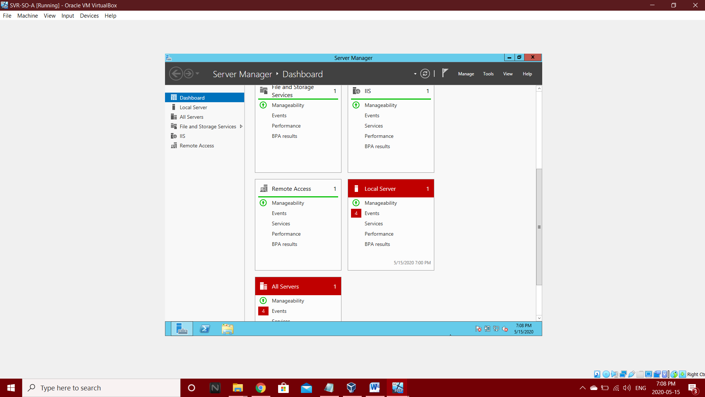
Network Setup and Configurations of Router (SVR-SO-A)
Add Roles and Features

Slide 17
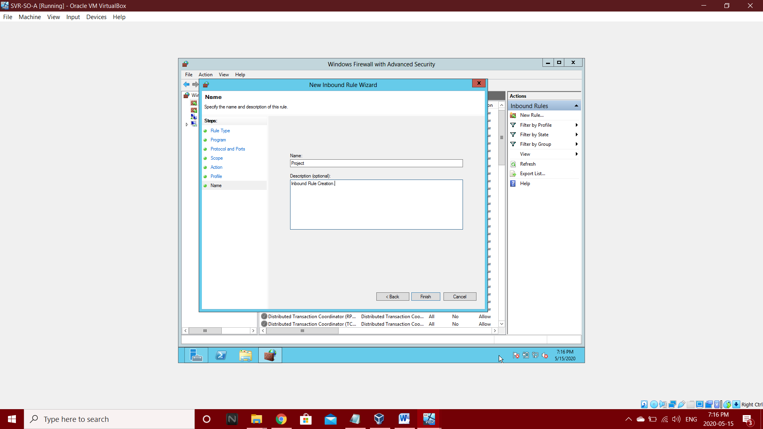
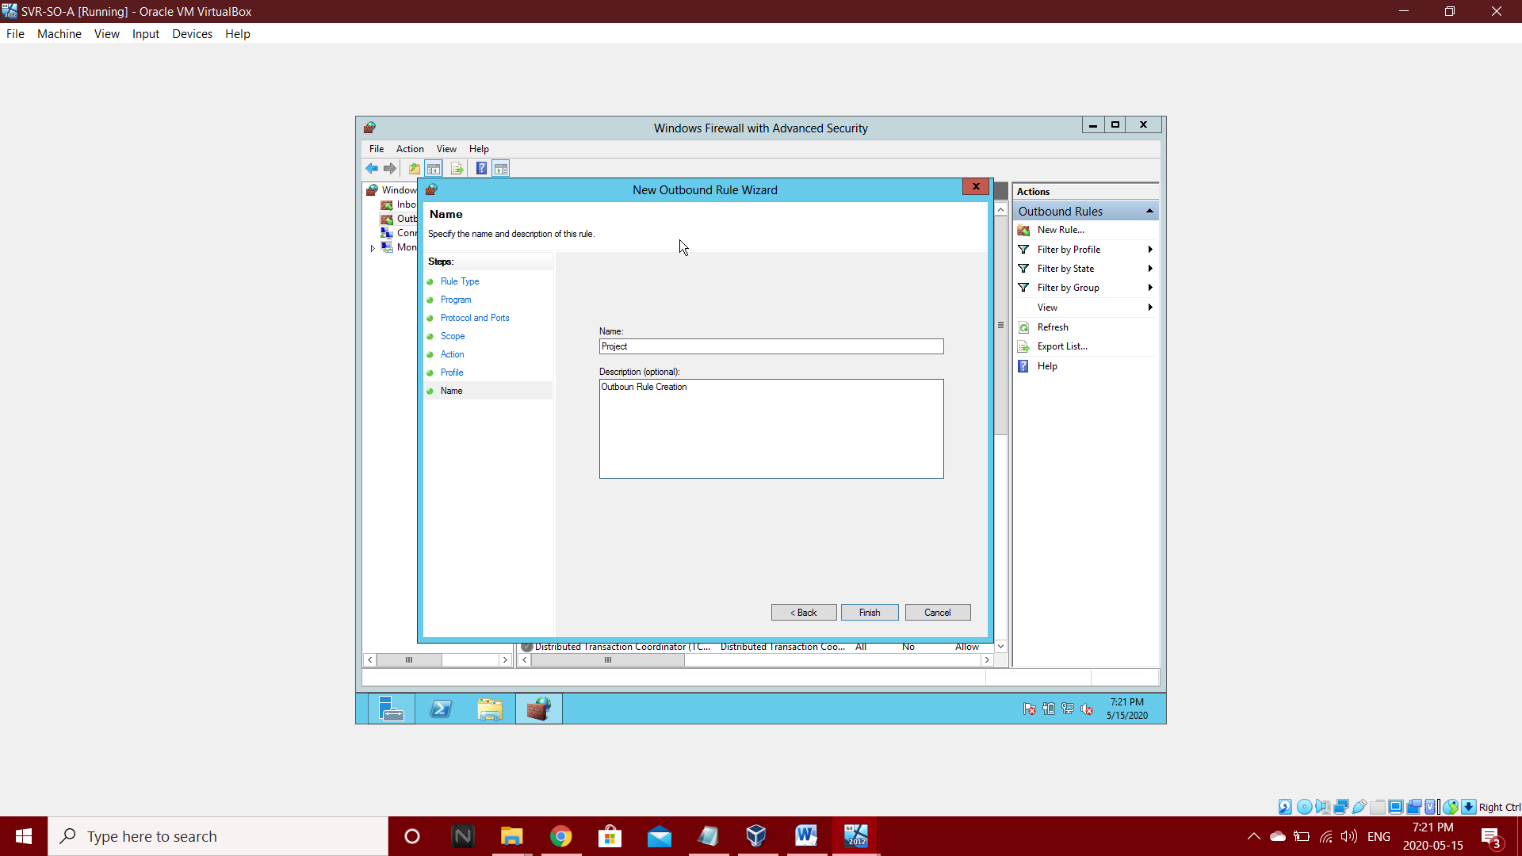
Add Inbound Rules
Add Outbound Rules

Slide 18
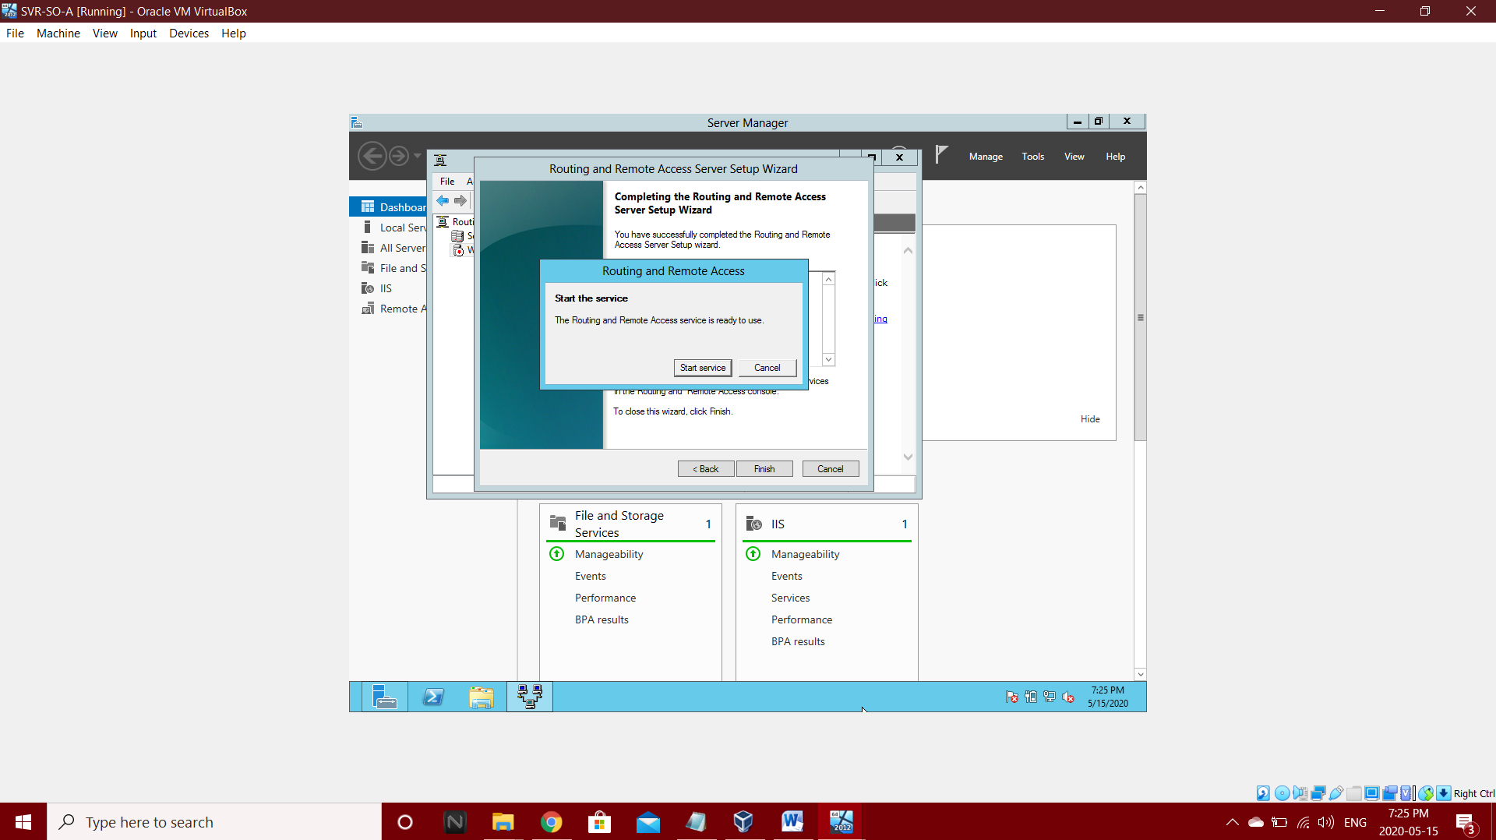
Add Routing and Remote Access

Slide 19
Network Setup and Configurations of Web-Server (SVR-WS-A)
Add Roles and Features
Add Inbound Rules
Add Outbound Rules
Add Routing and Remote Access

Slide 20
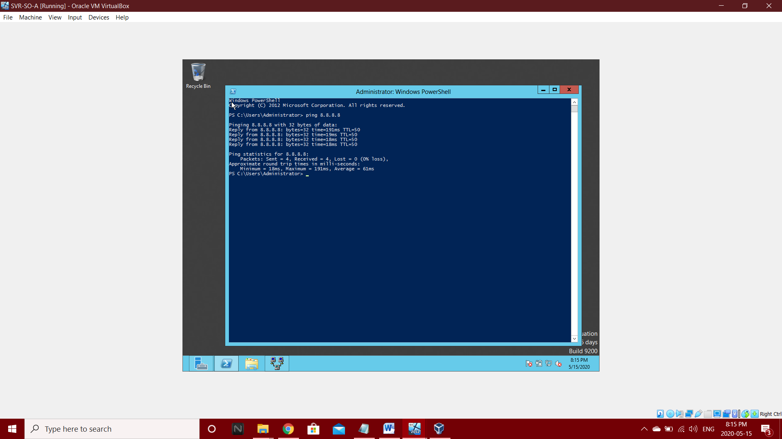
Network Utility
For Connection we need to do ping operations in command Prompt.
like ping 8.8.8.8

Slide 21
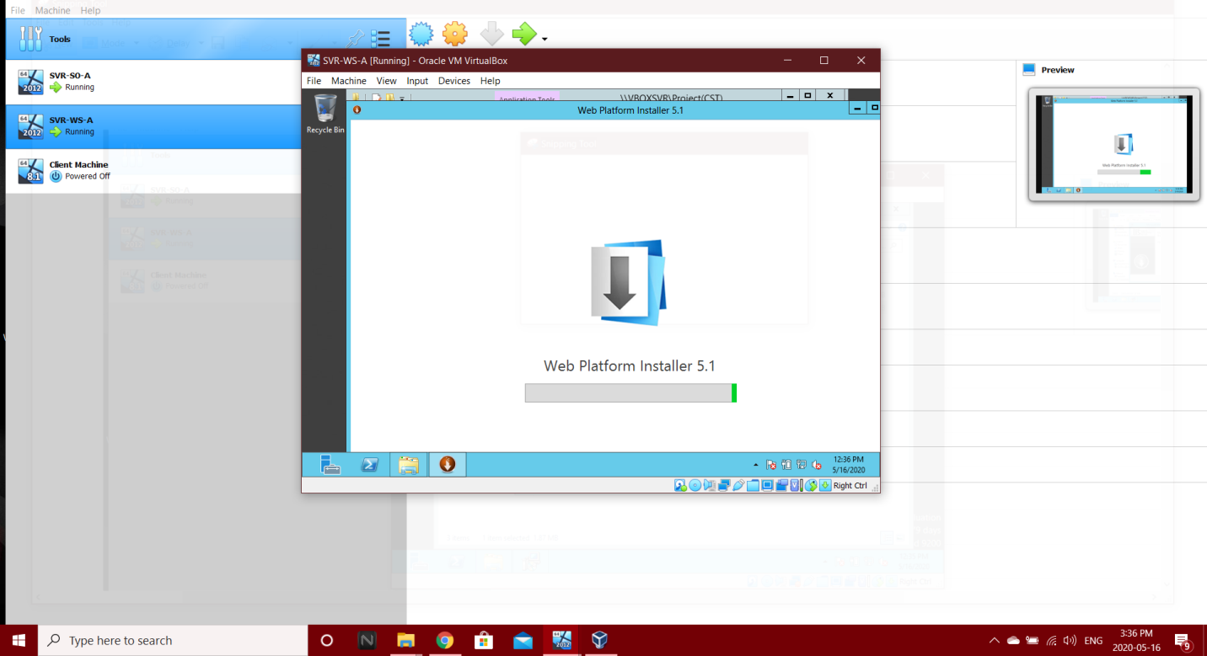
Web Platform Installation

Slide 22
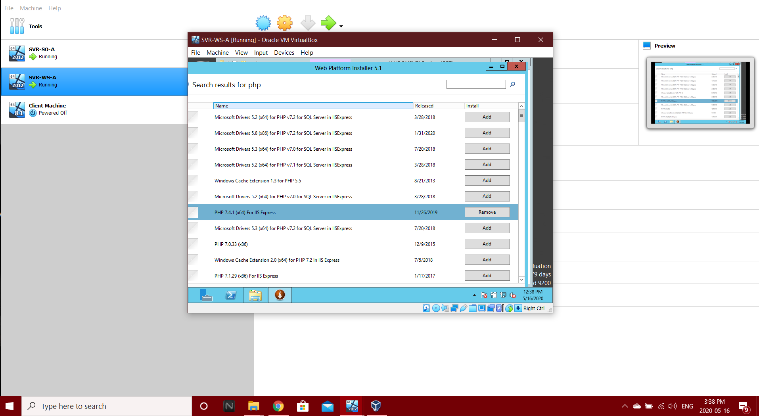
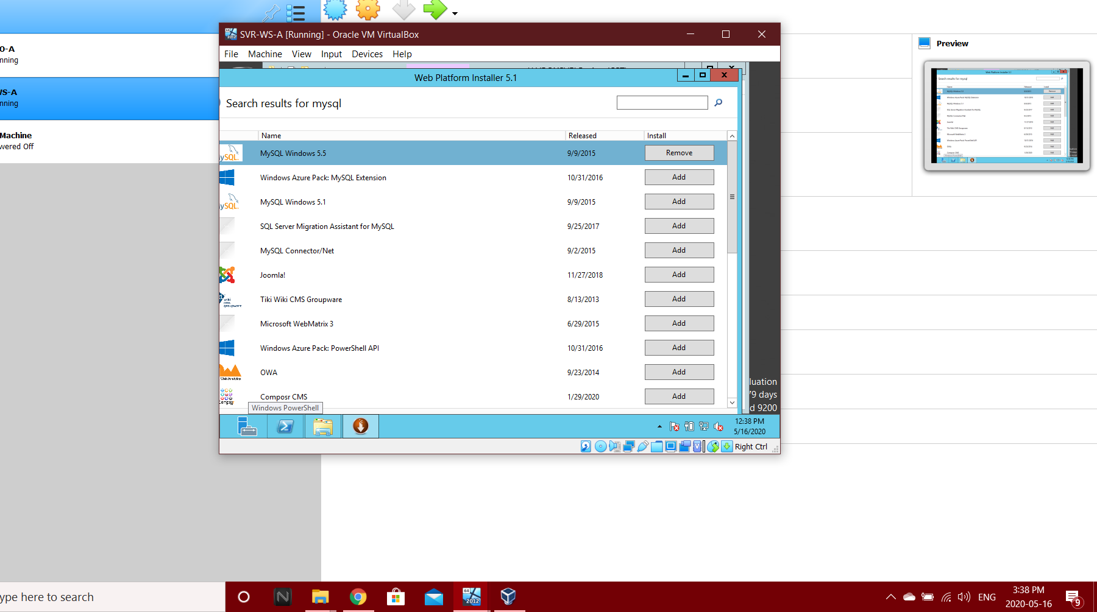
Installation of Web-Platform
Install PHP and MySQL from Web-platform.

Slide 23
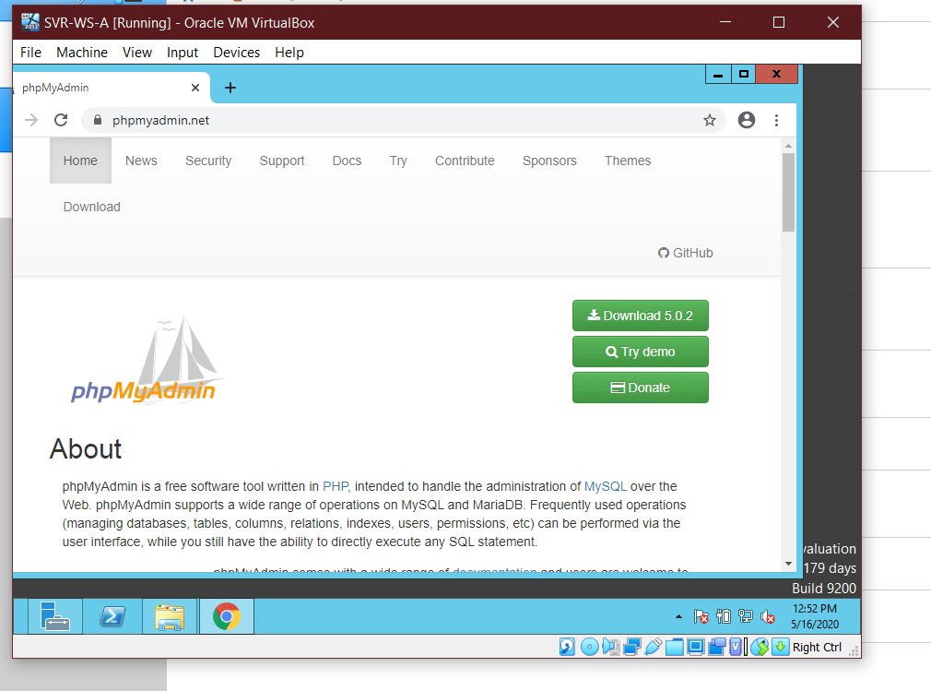
Host Web-Application
Download phpMyAdmin in Web-Server.
Add Final Project folder in Drive c/interpub/wwwroot/.

Slide 24
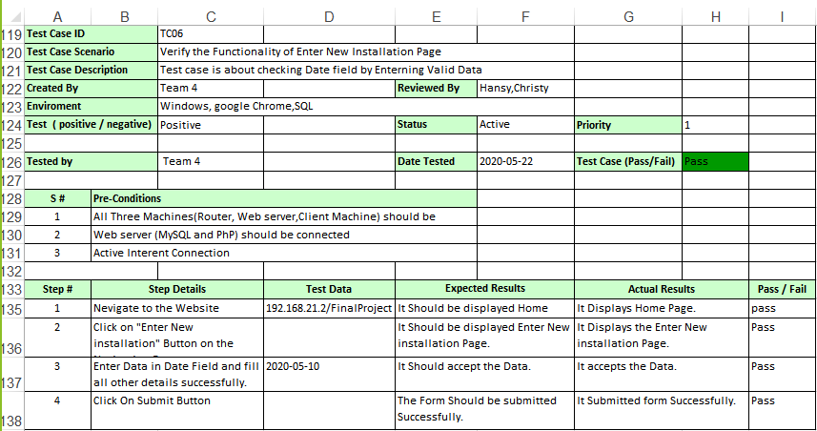
Test Cases Positive Test Case

Slide 25
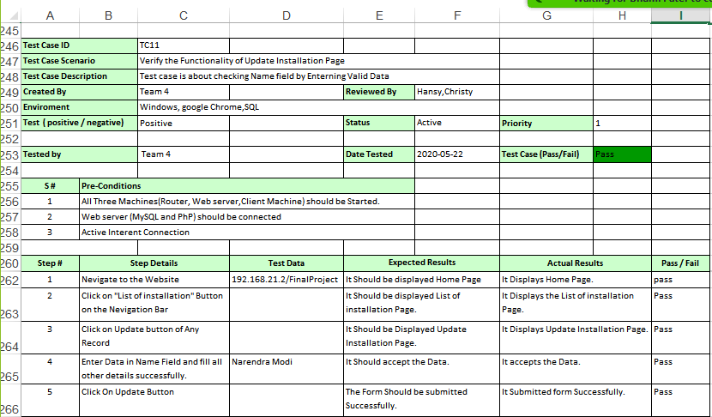

Slide 26
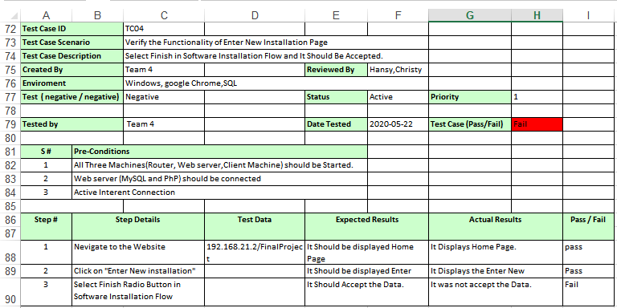
2) Negative Test Cases

Slide 27
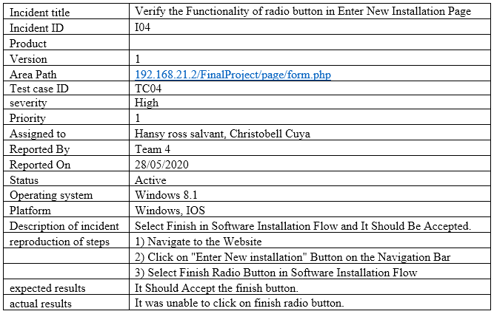

Slide 28
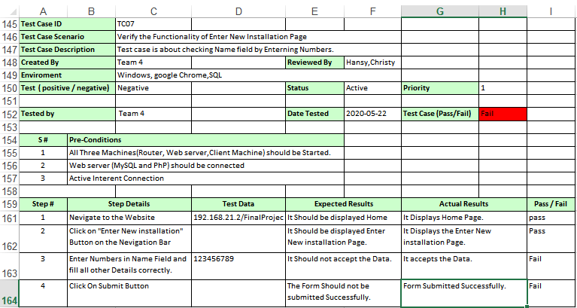

Slide 29
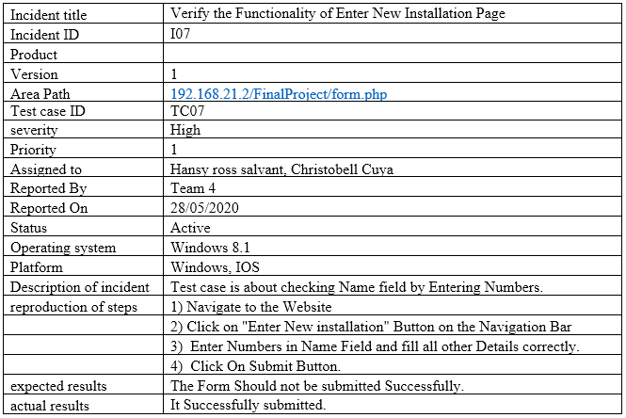

Slide 30
Conclusion
We understood the internal working of Router, Web-Server and Client Machine and its connectivity.
All three systems installed in virtual environment are connected to each other with IP Configuration.

Slide 31
Thank You

